Slide 1
SolutionPack for EMC VNX Watch4net Official Content v 1.0
2013-02-19 -- A.Lemay – Initial version
2013-02-21 -- A.Lemay – Title fix and text improvement

Slide 2
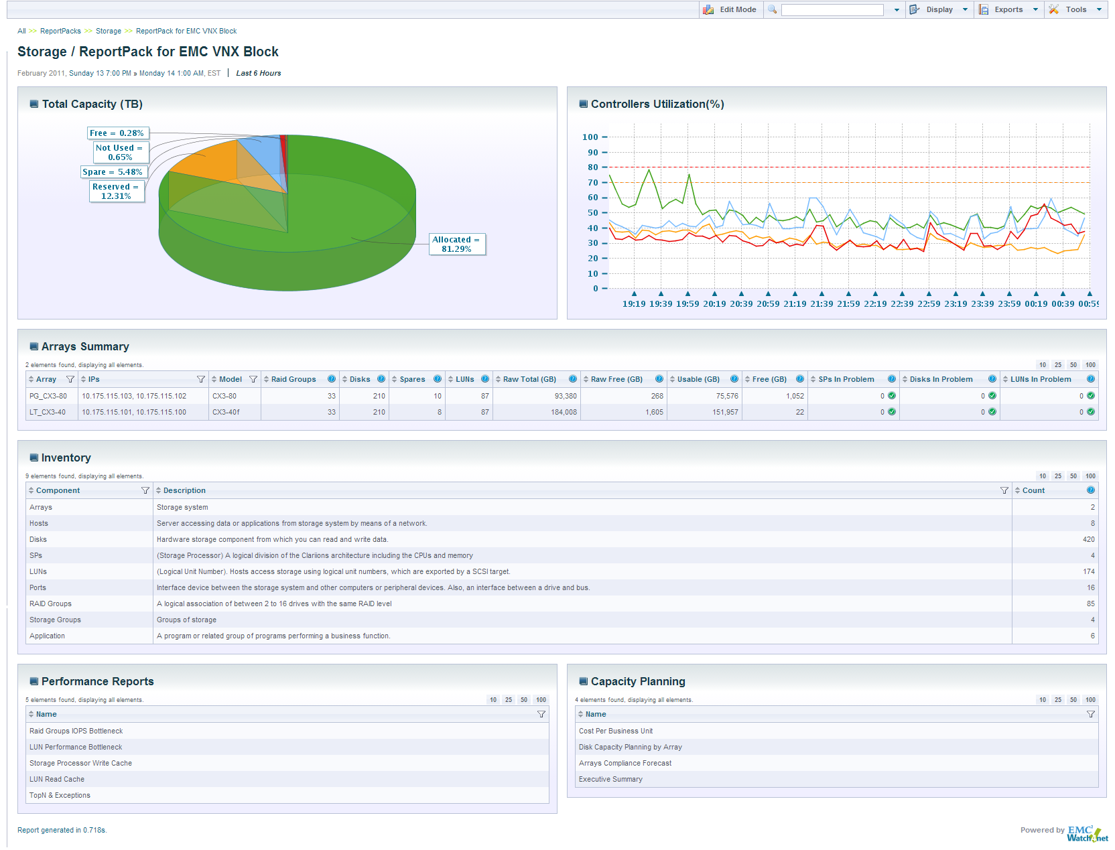
Global Dashboard
A Quick View of Controller Utilization
Specific VNX drill-down
VNX Infrastructure Inventory drill-down

Slide 3
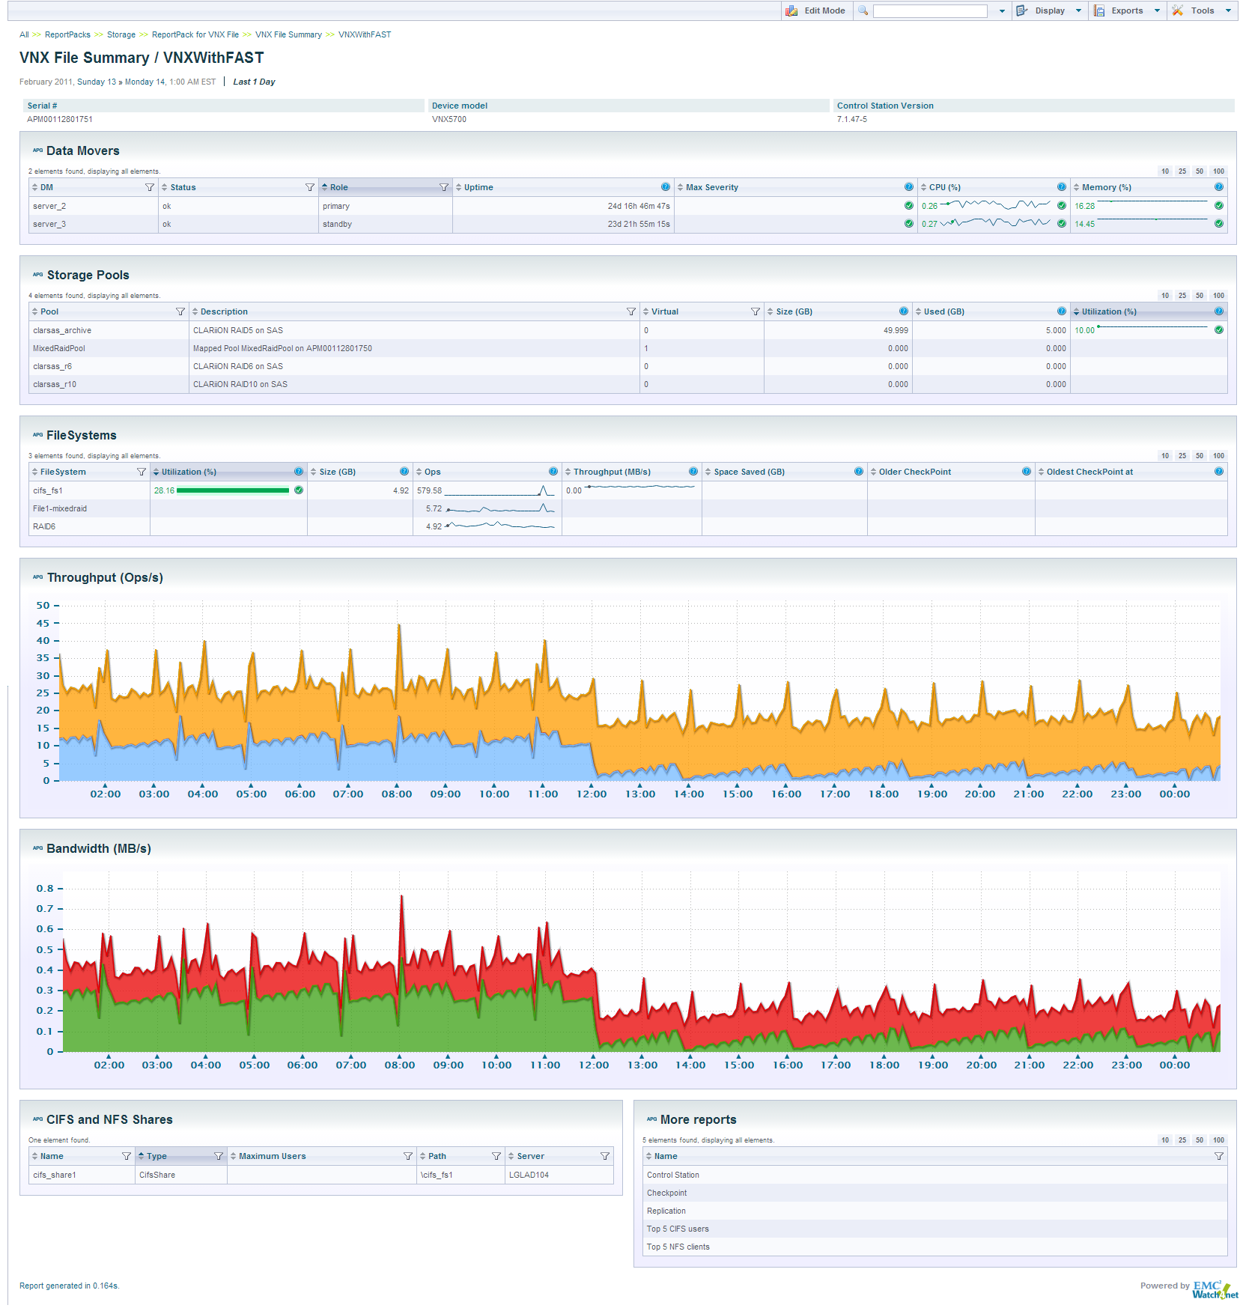
VNX File Detailed Statistics
Data Movers historical statistics
Related Storage Pools
FileSystem Share inventory

Slide 4
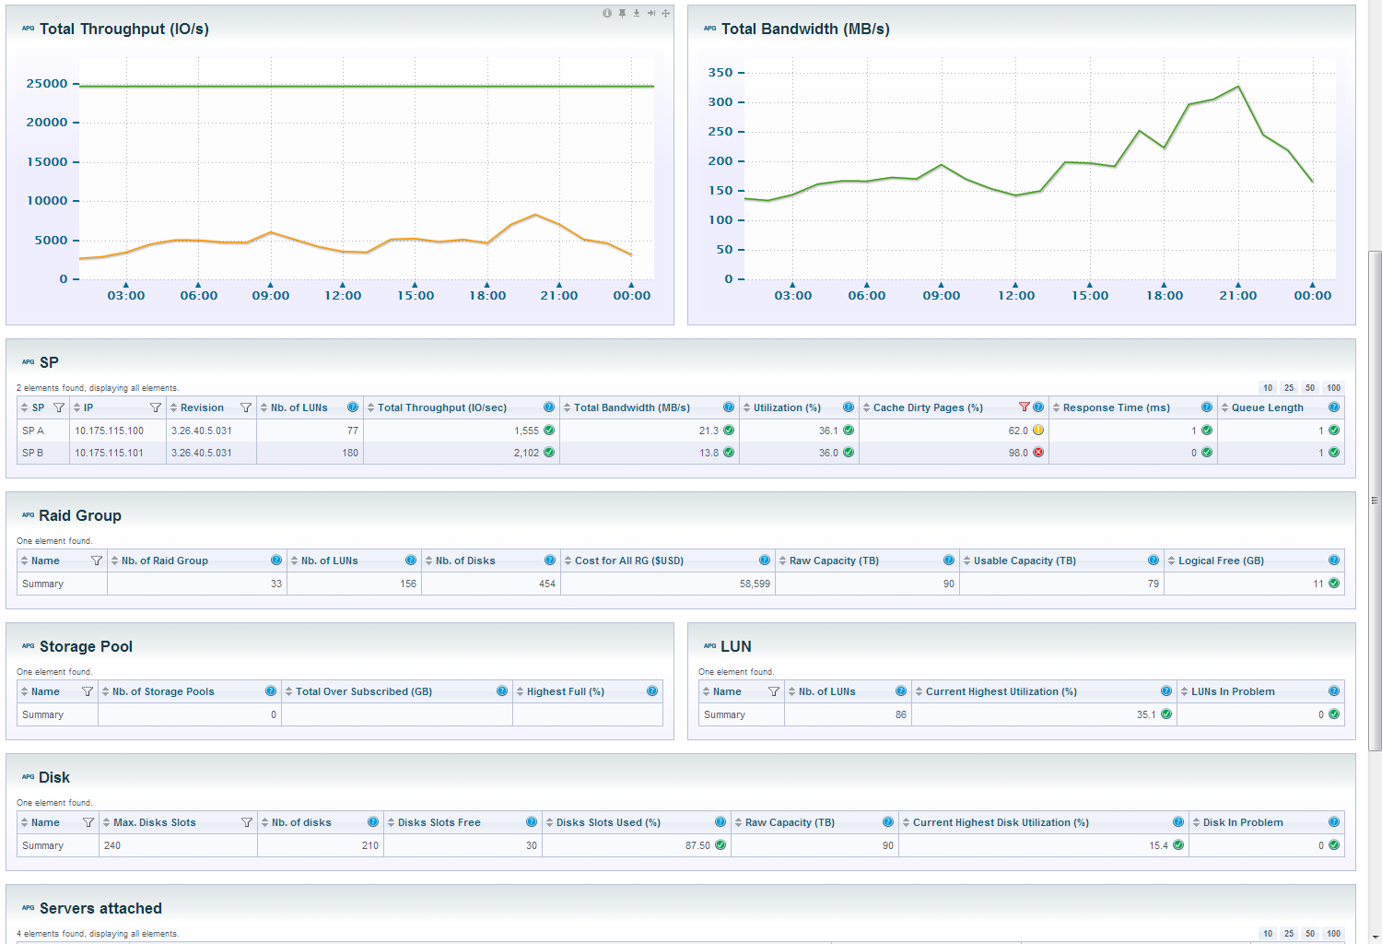
VNX Block Detailed Statistics
Service Processors
Raid Group drill-down
Storage Pool drill-down
Physical Disk drill-down

